Slide 1
Python Dashboard Project
Calvin Nastor and Navid Ghorbanali

Slide 2
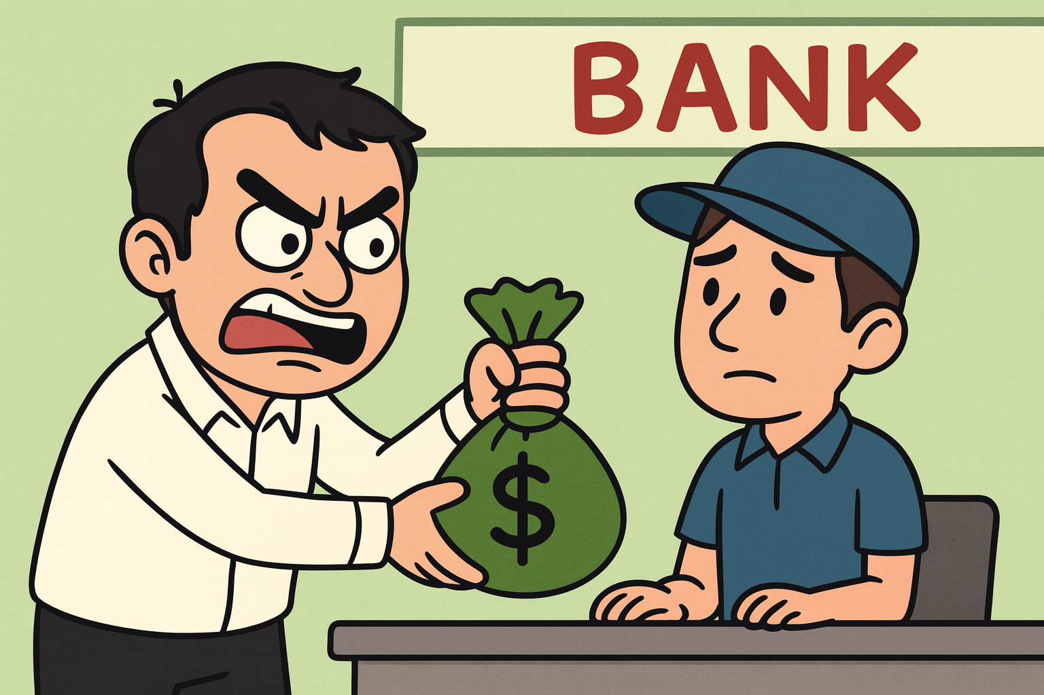
Problem Statement and Objective
CHALLENGE:
Design and implement a connected, multi-visual business dashboard that transforms cleaned dataset insights into interactive, actionable visualizations.
OBJECTIVE:
The objective is to develop an interactive Python dashboard that provides useful insights into business data, comparing both human- and AI-assisted code.

Slide 3
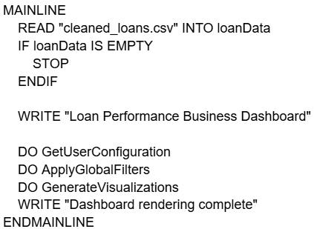
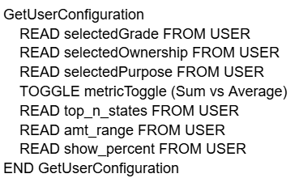
PseudoCode

Slide 4
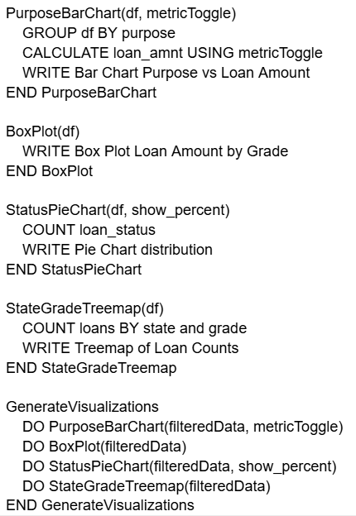
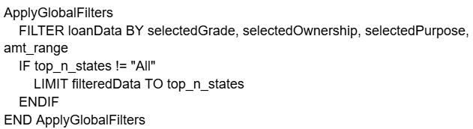
PseudoCode

Slide 5
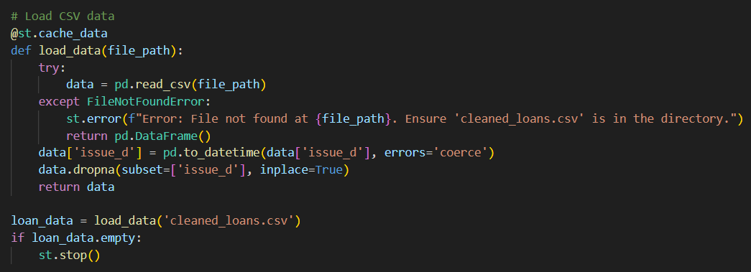
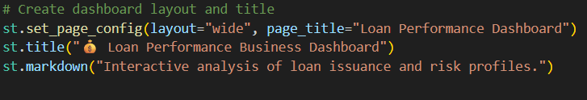
Dashboard Development

Slide 6
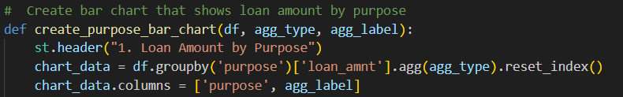
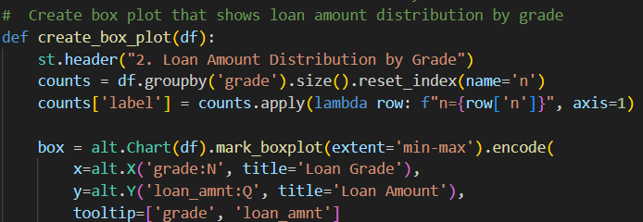

Slide 7
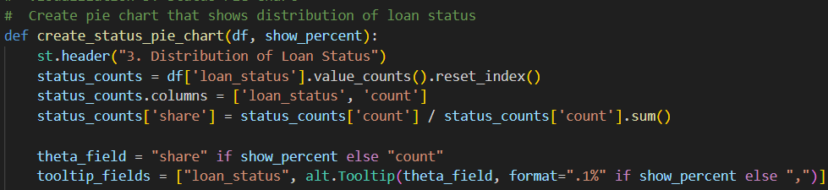
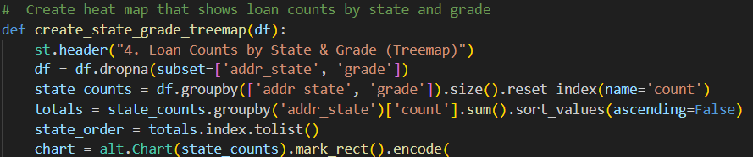
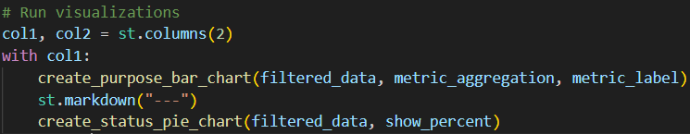

Slide 8
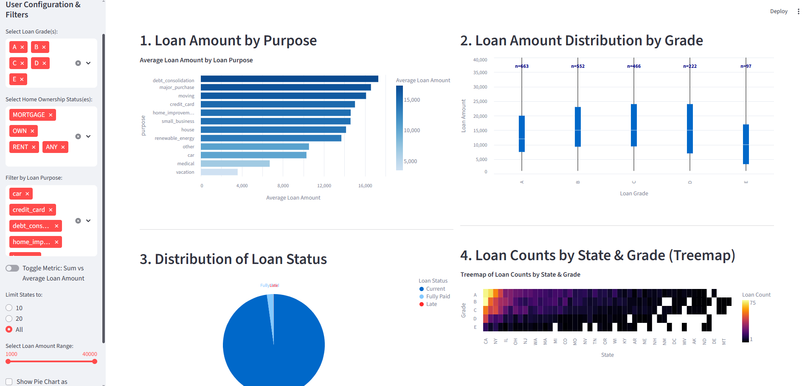

Slide 9
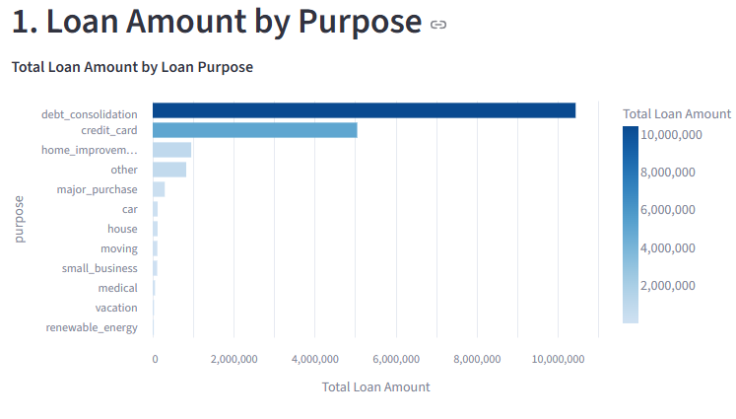
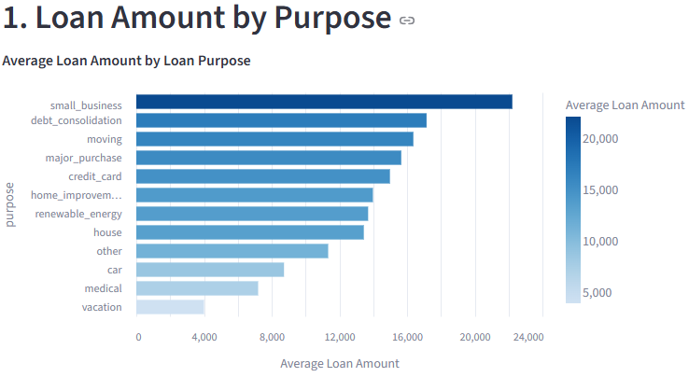
Feature Enhancements - Human
Average vs Total Toggle

Slide 10
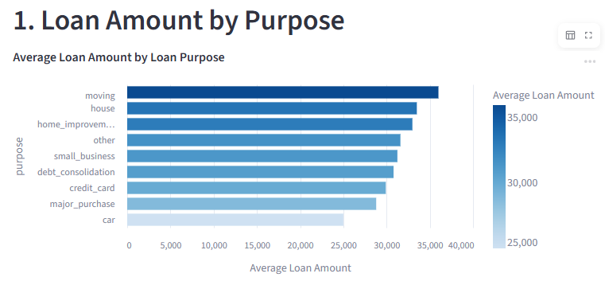
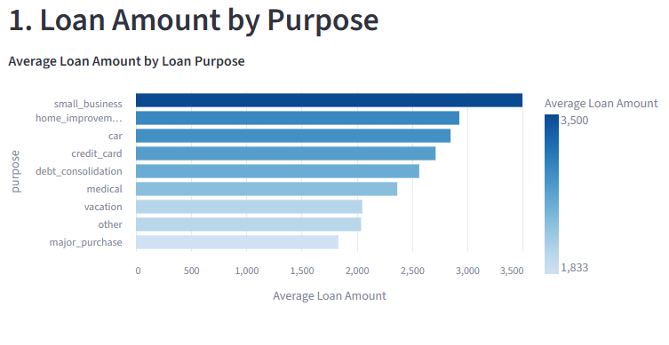
Feature Enhancements - Human
Loan Amount Slider

Slide 11
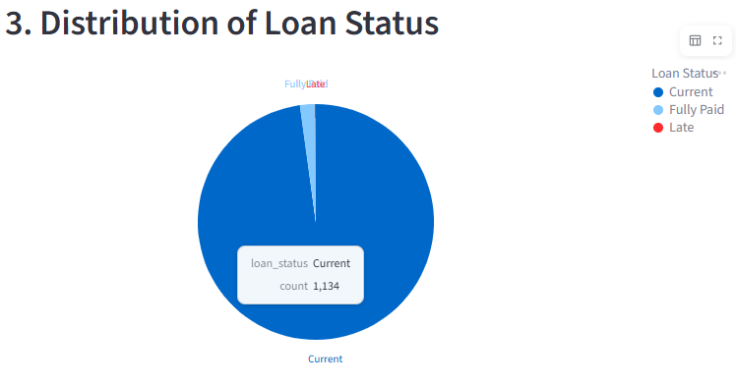
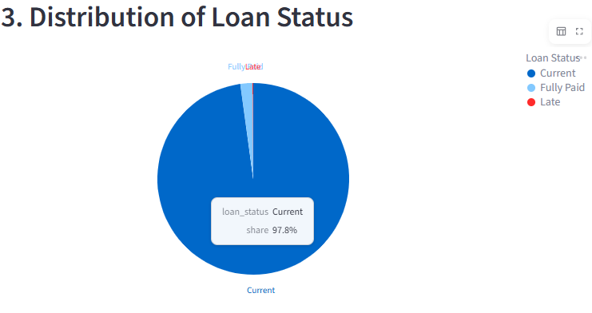
Feature Enhancements - Human
Percent vs Count Toggle

Slide 12


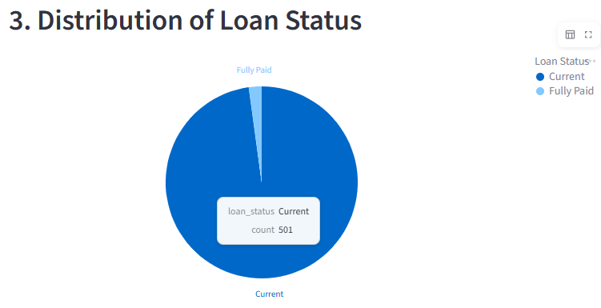
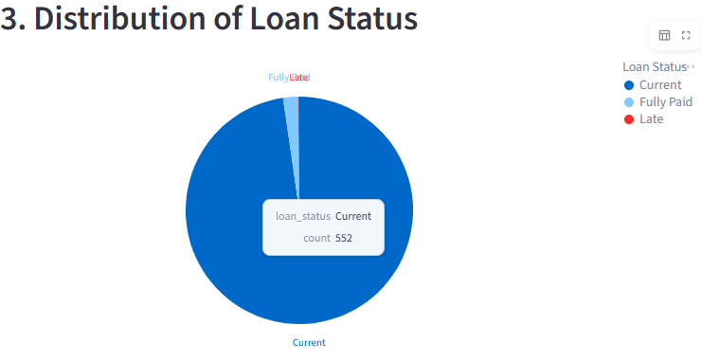
Feature Enhancements - Human
Filter by Homeownership

Slide 13
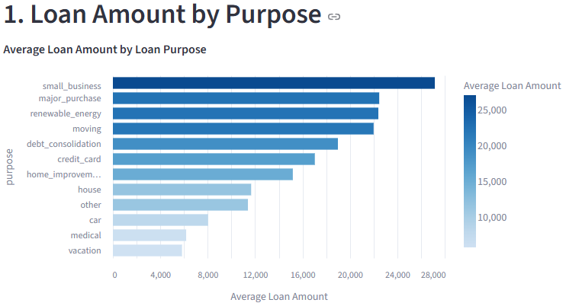
Feature Enhancements - AI
Shading

Slide 14
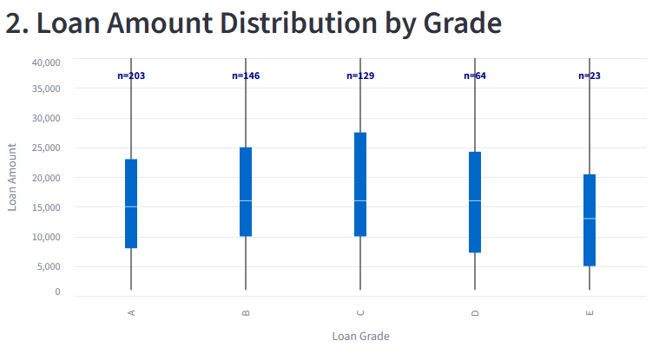
Feature Enhancements - AI
Sample Size Labels

Slide 15
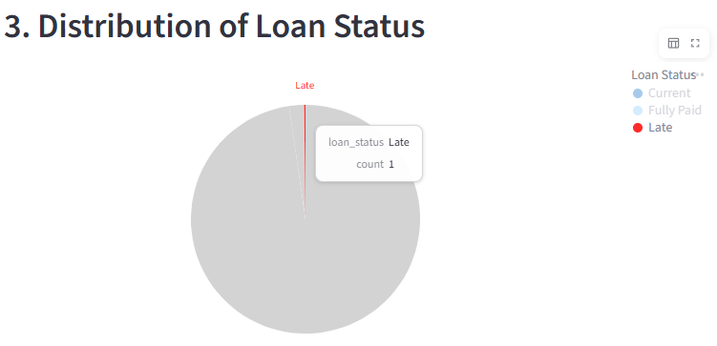
Feature Enhancements - AI
Highlight for Pie Chart

Slide 16
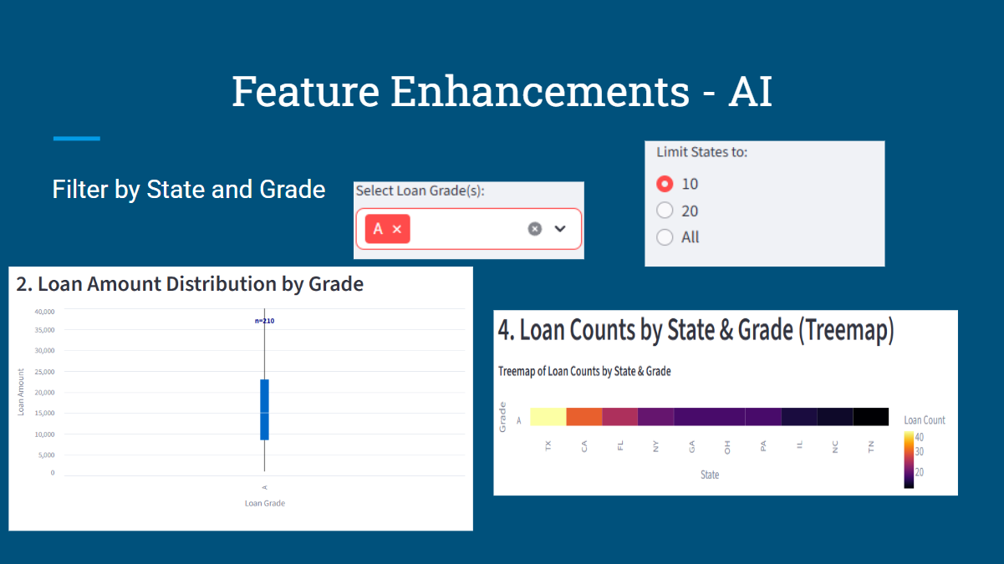

Slide 17
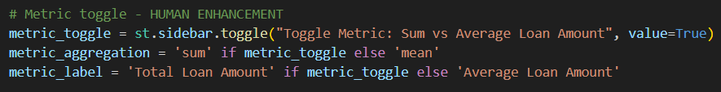
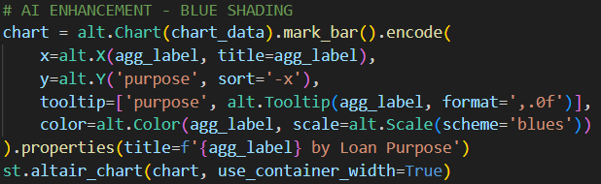
Visualization 1 Enhancements

Slide 18
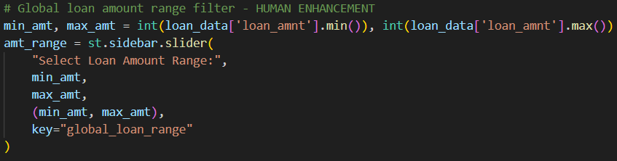
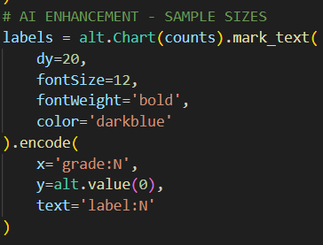
Visualization 2 Enhancements

Slide 19
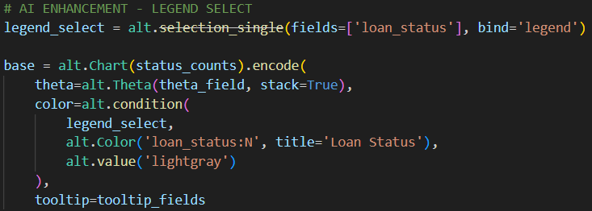
Visualization 3 Enhancements

Slide 20
Visualization 4 Enhancements

Slide 21
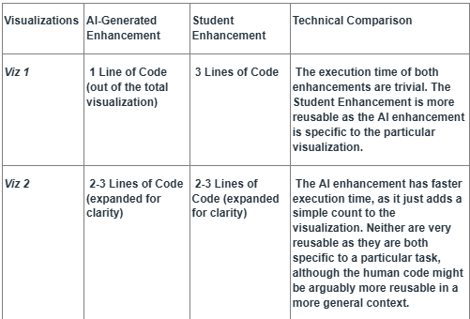
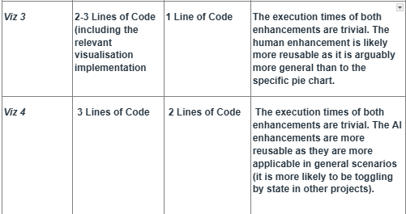
Comparative Evaluation: AI vs Human
Technical Comparison

Slide 22
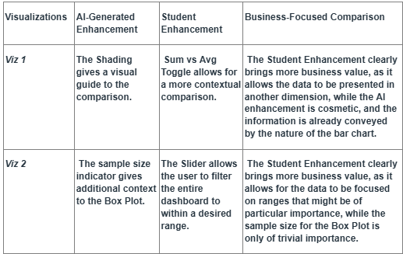
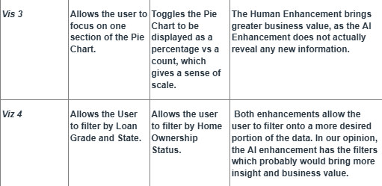
Business Focused Comparison

Slide 23
Analysis and Discussion
Overall, the AI generated enhancements were more efficient. They often worked after the first try, requiring no additional debugging. Furthermore, they were completed in seconds, making them much more time efficient. The downside is, as suggestions, they did not typically bring as much business value as the human ideas. We feel that the optimal approach would be for humans to come up with the enhancement idea, then have the AI implement it, subject to oversight.
The one major problem we ran into making the visualizations interactively linked was getting the filters and sliders (specifically, the loan amount slider) to work on every visualization at the same time. We initially had applied these aspects within the visualization functions, but it became apparent that we needed a different approach. We made the filters and sliders global, then applied them in the section before the visualization functions.

Slide 24
Conclusion
In this project, we used AI to collaborate with us to create a dashboard that would visually display relevant business information into four dynamic charts from our previously created dataset. In general, AI assistance was more a boon than a bane, as it greatly improved our productivity. However, it was not omnipotent, and as our experience in the enhancement section clearly demonstrates, AI must be used as a partner with humans in the development process, not the standalone driver.

